Slide 1
Deep Learning Summary
Anshu Pandey

Slide 2

Algorithms
Each problem has its own models!
The type of problem defines the feature engineering.
Image classification: CNNs (Resnet, VGG, densenet…)
Sound classification: CNNs, LSTM
Text classification: GBMs, Linear, DL, Naïve bayes, KNNs
Time series: AR models, ARIMA, Prophet ,linear, GBMs, DL, LSTMs
Categorical features: GBMs, Linear models, DL , LibFM, libFFm
Numerical Features: GBMs, Linear models, DL, SVMs
Interactions: GBMs, Linear models, DL
Recommenders: CF, DL, LibFM, LIBFFM, GBMs, KNN

Slide 3
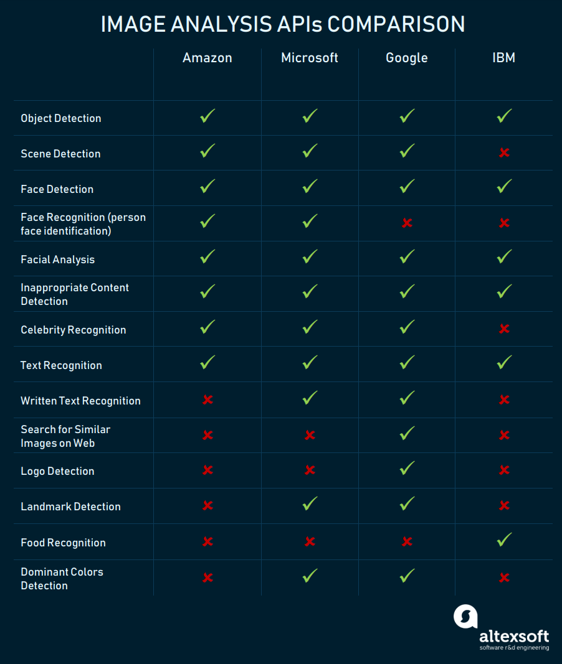
Comparison

Slide 4
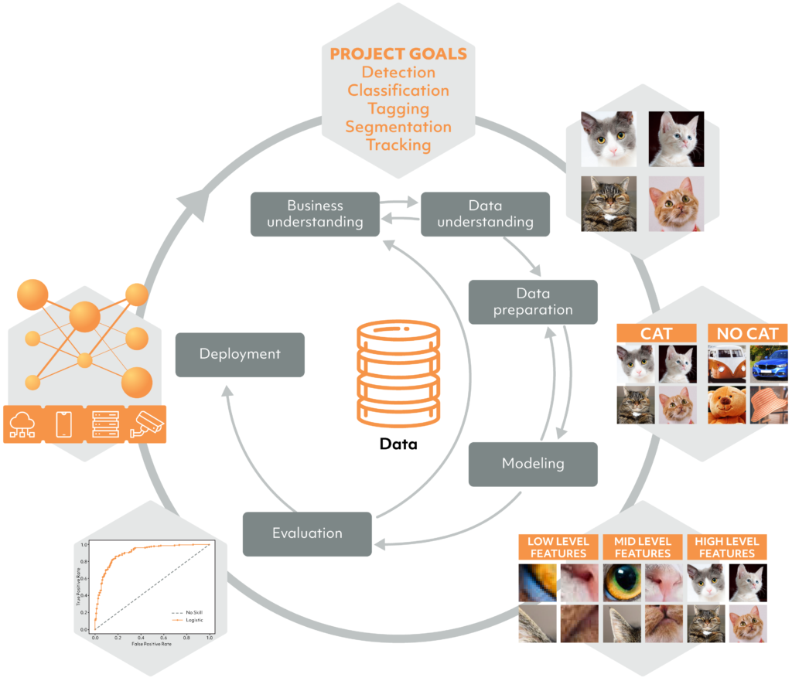
Computer Vision process flow

Slide 5
Data Preparation for a CV Project
Considerations while data preparation
Quantity – “enough volume of images”
Diversity – “images from a diverse set of perspectives, colors, or orientations”
Accuracy – “relevant images and accurate labels”
Quality – “the right images in high-quality resolution”
How to go about data preparation
Build project-specific data capture mechanisms
Use proprietary internal data
Find publicly available computer vision datasets
Generate synthetic data

Slide 7
CNN
Always start by using smaller filters is to collect as much local information as possible, and then gradually increase the filter width to reduce the generated feature space width to represent more global, high-level and representative information
Following the principle, the number of channels should be low in the beginning such that it detects low-level features which are combined to form many complex shapes(by increasing the number of channels) which help distinguish between classes.

Slide 8
CNN
General filter sizes used are 3x3, 5x5 and 7x7 for the convolutional layer for a moderate or small-sized images and for Max-Pooling parameters we use 2x2 or 3x3 filter sizes with a stride of 2. Larger filter sizes and strides may be used to shrink a large image to a moderate size and then go further with the convention stated.
Keep adding layers until you over-fit. As once we achieved a considerable accuracy in our validation set we can use regularization components like l1/l2 regularization, dropout, batch norm, data augmentation etc. to reduce over-fitting

Slide 9

CNN
Always use classic networks like LeNet, AlexNet, VGG-16, VGG-19 etc. as an inspiration while building the architectures for your models.
Don’t touch the first layers: The first hidden layers of a neural network tend to capture universal and interpretable features, like shapes, curves, or interactions that are very often relevant across domains. We should often leave these alone, and focus on optimizing the meta² latent level further back. This may mean adding hidden layers so we don’t rush the process!

Slide 10
High Bias / Underfitting
Get more features
Try additional polynomial features
No need for more observations
Increase the complexity of model
In case of NN – increase layers and mostly neurons on each layer
Try decreasing alpha – coefficient of regularization

Slide 11
High Variance/ Overfitting
Get more data – examples – rows
Reduce the number of features
No need for more features
Try Augmentation
Decrease complexity of model
Use Dropout, Normalization and Regularization
Try increasing alpha – coefficient of regularization

Slide 12
Dropout Best Practices:
If overfitting happens – which is usual
Use small dropouts of 20–50%, with 20% recommended for inputs. Too low and you have negligible effects; too high and you underfit.
Use dropout on the input layer as well as hidden layers. This has been proven to improve deep learning performance.
Use a larger network. You are likely to get better performance when dropout is used on a larger network, giving the model more of an opportunity to learn independent representations.

Slide 13
Optimization
Try different optimizers. You may start experiments with Adam;
Try to set different learning rates for different layers;
Freeze random layers on each step;
Start from small batch size and increase it during training;

Slide 14
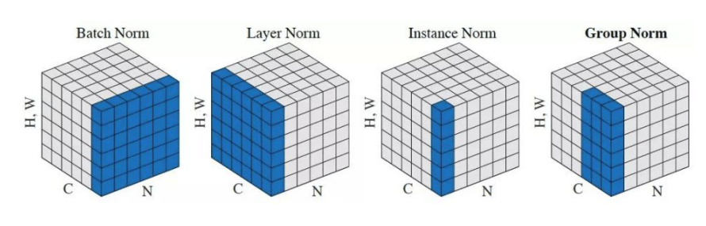
Normalization techniques

Slide 15
Best Practices -
Write basic pipeline or reuse a previous one
Define a very simple model for experiments
Starting with an interpretable model makes debugging easier.
Make metrics design and implementation a priority.

Slide 16
Deploying Machine Learning Models In Production
Factors to be considered when choosing a deployment medium:
Cost
Security
Proximity to data
Scalability
Programmatic Access (APIs)
Continuous Availability
Access Control

Slide 17
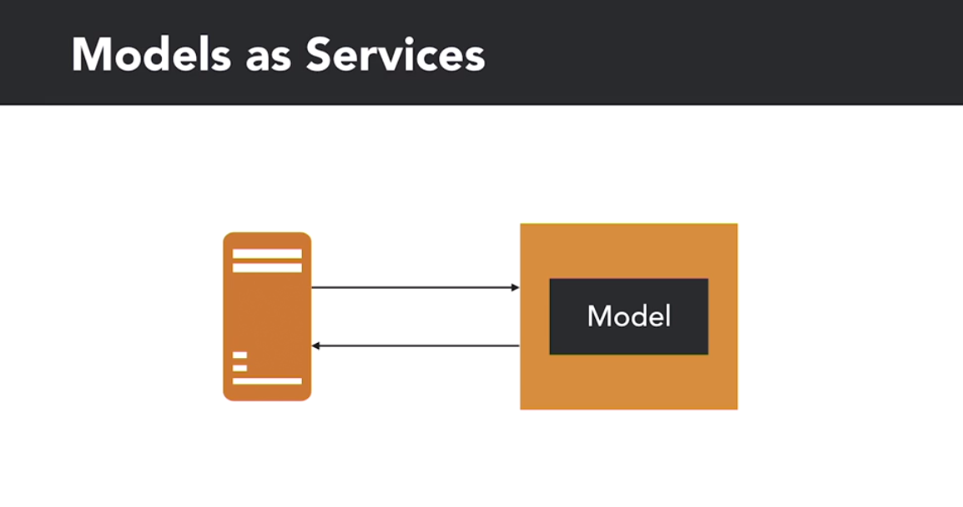

Slide 18
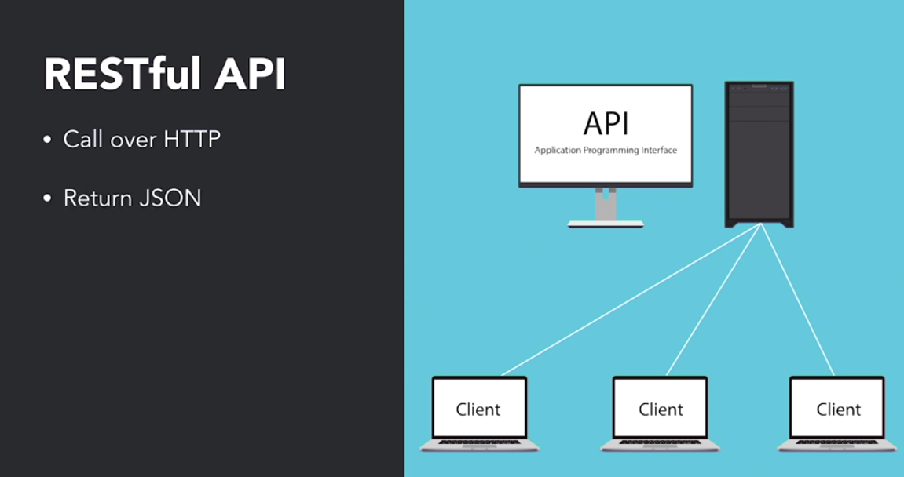

Slide 19
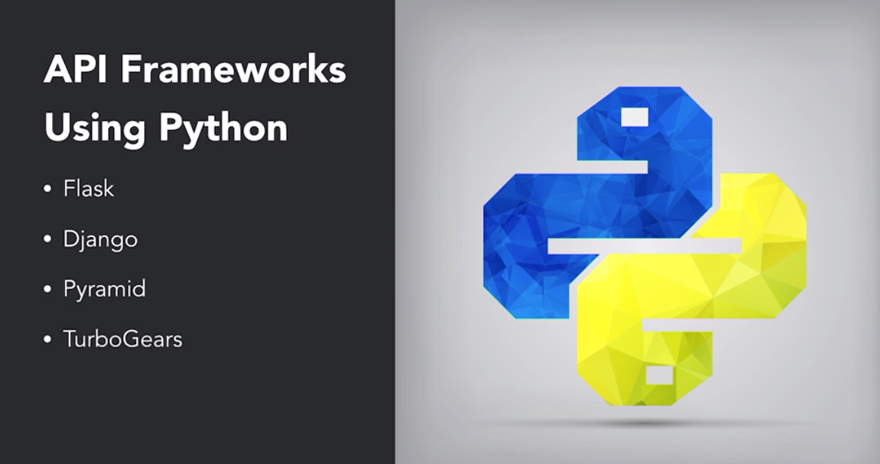

Slide 20
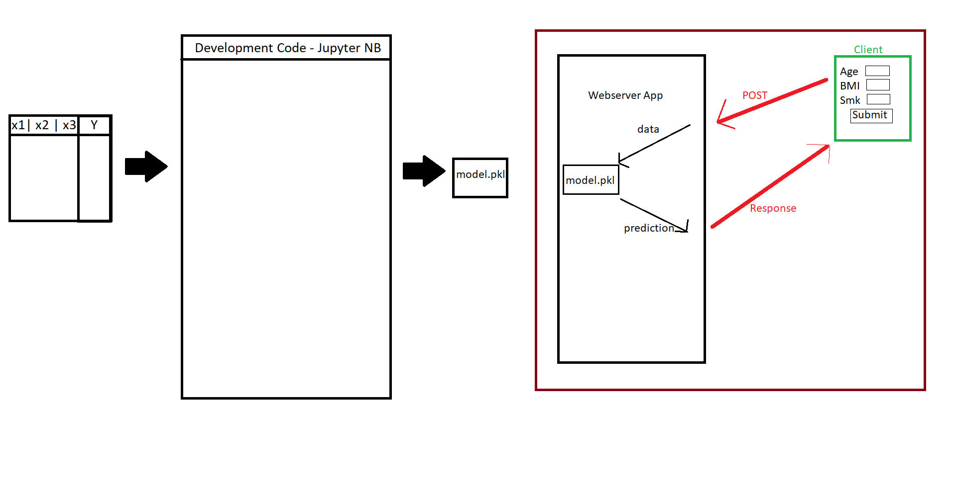

Slide 21
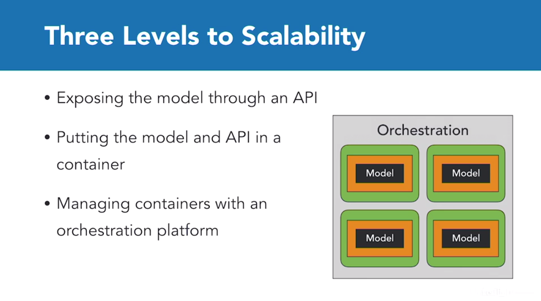

Slide 22
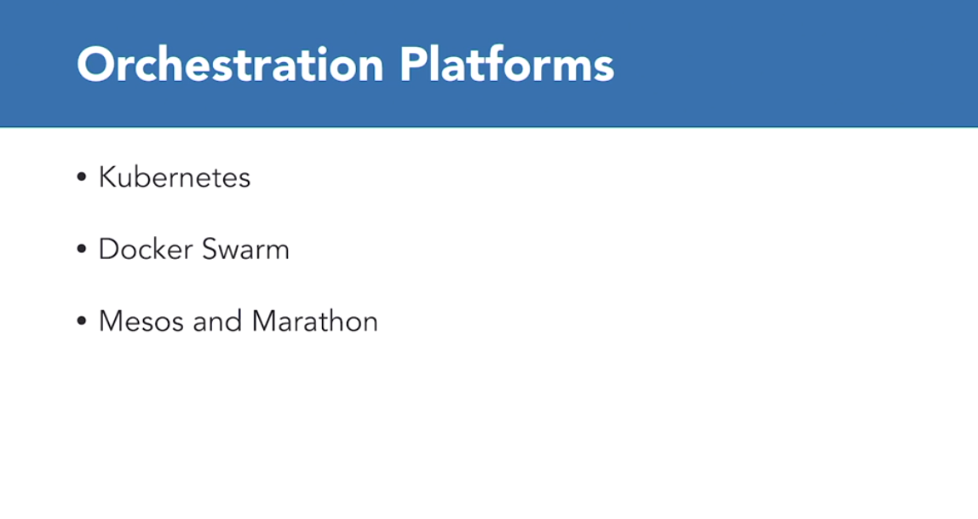

Slide 23
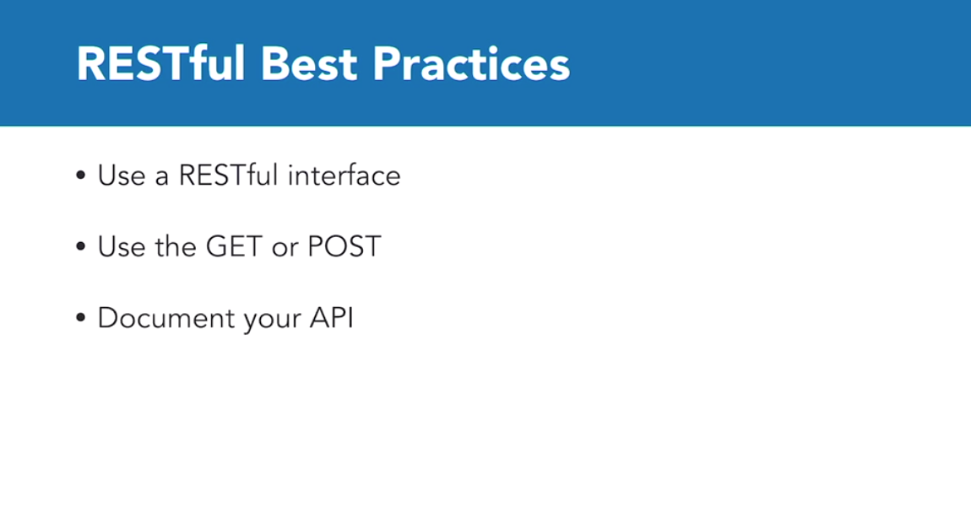

Slide 24
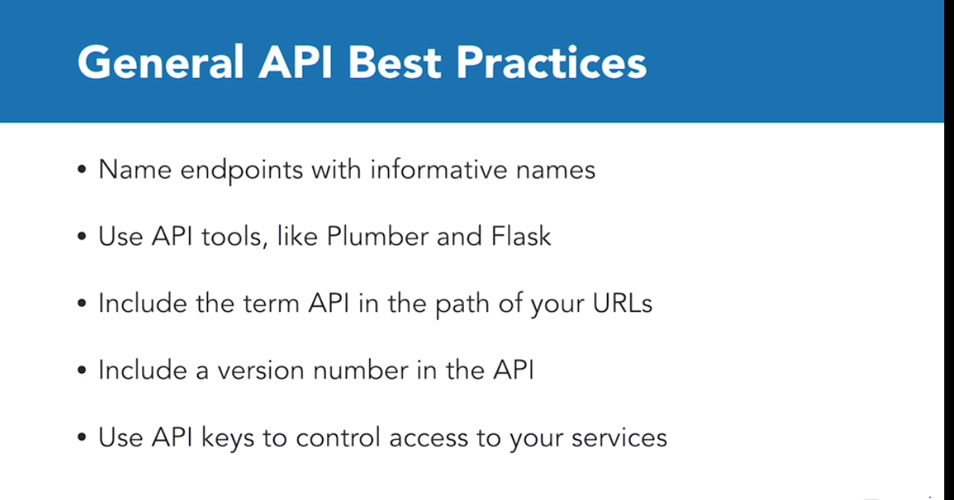

Slide 25
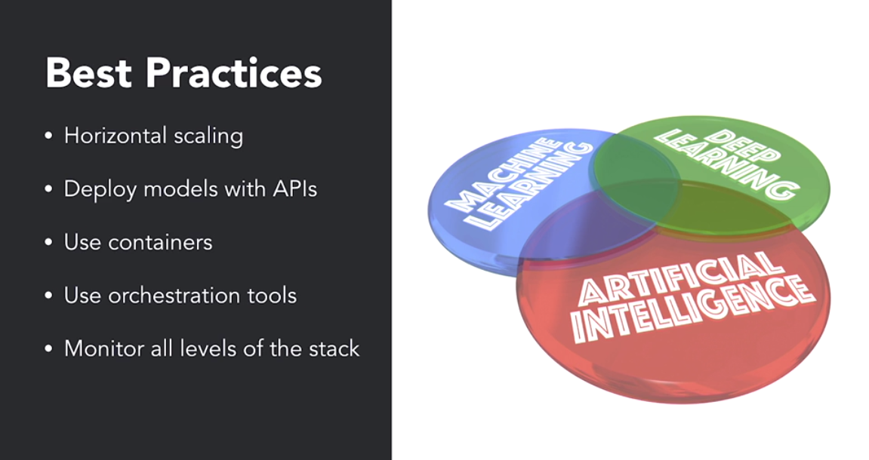

Slide 27
Questions?

